Slide 1
Swing in Front,
Grails in Back
Leveraging Grails with Swing

Slide 2
Abstract
Groovy and Grails have given us the ability to leverage the strength of the Java Platform (and Eco System) and the productivity of "Convention over Configuration" to construct websites. But what if the User Interface requirements of your new application is best solved with the type of interaction a desktop application provides?
Groovy brings the same productivity gain to desktop applications that Grails brings to web applications. This session will use the Groovy SwingBuilder and popular open source libraries to build a desktop application to interact with a Grails backend.

Slide 3

Introduction
My name is: Jim Shingler
Nationwide Insurance, Solution Architect
Beginning Groovy and Grails, Co-Author
FallME (Open Source),
Co-Founder
Inversion of Control for JavaME
ACORD Information Model Advisory Board

Slide 4

Common Complaints about Swing
Its hard
Have to code too much
Code is complex
Not many Advanced GUI Components

Slide 5
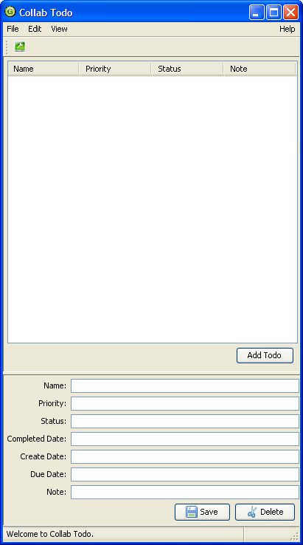
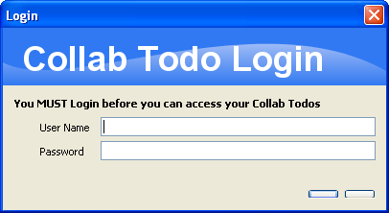
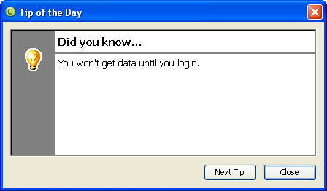
Goal
Menu Bar
Tool Bar
Login Dialog
Content Area
Tips Dialog
Status Bar

Slide 6
START SMALL

Slide 7

Okay, lets start small
How to use a Builder
How to add GUI Component
How to create an “About Box”
How to define and process action

Slide 8
Builders
The Builder Pattern is a software design pattern. The intention is to separate the construction of a complex object from its representation so that the same construction process can create different representations.
Often, the Builder Pattern is used to build Products in accordance to the Composite pattern, a structure pattern.
Source: Wikipedia
Swing is a complex hierarchy, . . . Sounds like an opportunity

Slide 9
Groovy GUI Builders
SwingBuilder
Applies the Builder Pattern to the construction of Swing.
“Makes Swing Groovy”
SwingXBuilder
Extends SwingBuilder adding SwingLabs Components
JideBuilder
Extends SwingBuilder adding JIDE Components
GroovySWT (Builder)
Applies the Builder Pattern to the construction of SWT.
“Makes SWT Groovy”

Slide 10

The Builder and the Button
import groovy.swing.SwingXBuilder
import static javax.swing.WindowConstants.EXIT_ON_CLOSE
import javax.swing.*
class SimpleUI {
def swing
def run = {
swing = new SwingXBuilder()
swing.lookAndFeel('system')
// Define the Frame
swing.frame(id:'simpleUIFrame', title: 'SimpleUI', location: [100,100],
defaultCloseOperation: EXIT_ON_CLOSE ) {
// Define some stuff
button(id:'clickButton', text:"Click Me")
}
swing.simpleUIFrame.pack()
swing.simpleUIFrame.show()
}
}
new SimpleUI().run()

Slide 11
Learning to Count
def count = 0
. . .
swing.lookAndFeel('system')
// create the actions
swing.action(id: 'clickAction',
name: 'Click',
closure: this.&click,
shortDescription: 'Increment the Click Count'
)
// Define the Frame
. . .
void click(event) {
count++
swing.clickButton.text = "Clicked ${count} time(s)."
}
. . .

Slide 12

Learning to Count,
Attach the action
button(id:'clickButton', text:"Click Me", action: clickAction)
YEAH – I can count

Slide 13
MenuBar and Actions
. . .
swing.action(id: 'exitAction',
name: 'Exit', closure: this.&exit,
mnemonic: 'x', accelerator: 'F4',
shortDescription: 'Exit SimpleUI'
)
swing.action(id: 'aboutAction',
name: 'About', closure: this.&showAbout,
mnemonic: 'A', accelerator: 'F1',
shortDescription: 'Find out about SimpleUI'
)
. . .
// Define the Menubar
menuBar {
menu(text: 'File', mnemonic: 'F') {
menuItem(exitAction)
}
glue()
menu(text: 'Help', mnemonic: 'H') {
menuItem(aboutAction)
}
}

Slide 14
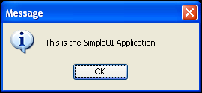
MenuBar and Actions
. . .
void showAbout(event) {
JOptionPane.showMessageDialog(swing.simpleUIFrame,
'''This is the SimpleUI Application''')
}
void exit(event) {
System.exit(0)
}

Slide 15
SimpleUI Review
Used SwingXBuilder to create
Swing components
Added a Button to the frame
Learned to count
Added a MenuBar with:
File > Exit
Help > About

Slide 16
RETURN TO THE GOAL

Slide 17
Review: Parts of a User Interface
Menu Bar
Tool Bar
Login Dialog
Content Area
Tips Dialog
Status Bar

Slide 18



Planning
Menu Bar
Tool Bar
Status Bar
About Box
Tips
Login Dialog
Master / Detail Content Area
  Table and Fields
Wire it together with Actions
Make calls to Web Service
✓
✓
Glazed Lists
✓

Slide 19
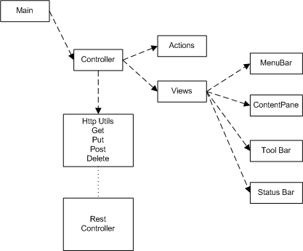
Organize your code

Slide 20
Main
package com.apress.bgg.ui
import com.apress.bgg.ui.Controller
class Main {
static void main(args) {
. . .
def controller = new Controller()
controller.run()
}
}

Slide 21
Controller
package com.apress.bgg.ui
import . . .
class Controller {
. . .
def run = { . . . } // Create Builder and Init
void exit(event) { . . . } // End Application
void doTips() { . . . } // Display Tips Dialog
void showTips(event) { doTips() }
void showAbout(event) { . . . } // Display About Dialog
void showLogin(event) { . . . } // Display Login Dialog
void showToolbar(event) { . . . } // Display Toolbar
def status = { . . . } // Add Message to Status
void loadUserInfo() { . . . } // Load User info on login
void loadData() { . . . } // Get Data from WS
void deleteTodo(event) { . . . } // Delete Data using WS
void saveTodo(event) { . . . } // Save Data using WS
. . .

Slide 22
Controller – run()
def run = {
todoEventList = new BasicEventList()
swing = new SwingXBuilder()
// adjust the look and feel aspects.
swing.lookAndFeel('system')
// add controller to the swingBuilder bindings
swing.controller = controller
// create the actions
swing.build(Actions)
// create the view
swing.build(Views)
swing.consoleFrame.pack()
swing.consoleFrame.show()
}
swing.build(script) executes the script. This is very useful, it provides the ability to organize the code

Slide 23
Actions
package com.apress.bgg.ui
import java.awt.event.InputEvent
import java.awt.event.KeyEvent
import javax.swing.KeyStroke
action(id: 'tipsAction',
name: 'Tips', closure: controller.&showTips,
mnemonic: 'T', shortDescription: 'Tips')
action(id: 'loginAction',
name: 'Login', closure: controller.&showLogin,
mnemonic: 'L', shortDescription: 'Login to the Collab Todo Service',
smallIcon: imageIcon(resource:"icons/login.png", class:this))
action(id:'showToolbarAction',
name: 'Show Toolbar', closure: controller.&showToolbar, mnemonic: 'T')
action(id: 'addAction',
name: 'Add Todo', closure: controller.&addTodo,
mnemonic: 'A', accelerator: shortcut('A'),
shortDescription: 'Add Todo')
action(id: 'saveAction',
name: 'Save', closure: controller.&saveTodo,
mnemonic: 'S', accelerator: shortcut('S'),
smallIcon: imageIcon(resource:"icons/disk.png", class:this),
shortDescription: 'Save', enabled: true )

Slide 24
Views
package com.apress.bgg.ui
import com.apress.bgg.ui.view.*
import javax.swing.UIManager
import static javax.swing.WindowConstants.DO_NOTHING_ON_CLOSE
switch (UIManager.getSystemLookAndFeelClassName()) { . . .
default:
build(Defaults); break
}
frame(
title: 'Collab Todo', location: [100,100],
iconImage: imageIcon(Controller.ICON_PATH).image,
defaultCloseOperation: DO_NOTHING_ON_CLOSE,
id:'consoleFrame'
) {
build(menuBarClass)
build(contentPaneClass)
build(toolBarClass)
build(statusBarClass)
}
// add the window close handler
consoleFrame.windowClosing = controller.&exit
controller.statusLabel = status
controller.frame = consoleFrame
controller.toolbar = toolbar
swing.build(script) executes the script. This is very useful, it provides the ability to organize the code

Slide 25
Review: Parts of a User Interface
Menu Bar
Tool Bar
Login Dialog
Content Area
Tips Dialog
Status Bar

Slide 26
MenuBar
package com.apress.bgg.ui.view
menuBar {
menu(text: 'File', mnemonic: 'F') {
menuItem(loginAction)
separator()
menuItem(exitAction)
}
menu(text: 'Edit', mnemonic: 'E') {
menuItem(addAction)
menuItem(deleteAction)
menuItem(saveAction)
}
menu(text: 'View', mnemonic: 'V') {
checkBoxMenuItem(fullStackTracesAction, selected: controller.fullStackTraces)
checkBoxMenuItem(showToolbarAction, selected: controller.showToolbar)
}
glue()
menu(text: 'Help', mnemonic: 'H') {
menuItem(aboutAction)
menuItem(tipsAction)
}
}
Controller {
void fullStackTraces(event) { . . . }
void showToolbar(event) { . . . . }
}

Slide 27
ToolBar
package com.apress.bgg.ui.view
toolBar(id:'toolbar', rollover:true, visible:controller.showToolbar) {
button(loginAction, text:null)
}
Controller {
. . .
void showLogin(event) {
if (!loginPane) { . . . }
loginPane.showLoginDialog(frame, loginPane)
loadUserInfo()
loadData()
}}
action(id: 'loginAction',
name: 'Login',
closure: controller.&showLogin,
. . .
)

Slide 28
StatusBar
package com.apress.bgg.ui.view
import org.jdesktop.swingx.JXStatusBar.Constraint
import org.jdesktop.swingx.JXStatusBar.Constraint.ResizeBehavior
statusBar() {
label(id: 'status',
text: 'Welcome to Collab Todo.',
constraints: new Constraint(ResizeBehavior.FILL)
)
label(id: 'status2',
text: '', preferredSize : [50, 10],
constraints: new Constraint(ResizeBehavior.FIXED))
}
Controller {
def status = {message -> swing.status.text = "$message"}
}

Slide 29
Review: Parts of a User Interface
Menu Bar
Tool Bar
Content Area
Status Bar

Slide 30
Content Pane
Glazed Lists
// Define a Summary Table
def columnNames = ["Name", "Priority", "Status", "Note"]
def summaryTable = scrollPane() {
table(id: 'table',
model: new EventTableModel(todoEventList, [
getColumnCount: { return columnNames.size() },
getColumnName: { index -> columnNames[index] },
getColumnValue: { object, index -> object."${columnNames[index].toLowerCase()}".text()
}] as TableFormat))
table.setSortable(false)
}

Slide 31
Content Pane
Glazed Lists
// Layout the Summary Table
splitPane(id: 'splitPane', resizeWeight: 0.50F, orientation: VERTICAL_SPLIT) {
// Setup the Summary Table form using JGoodies Forms
FormLayout layout = new FormLayout(
"3dlu, 200dlu, 3dlu, pref, 3dlu, pref,3dlu", // columns
"3dlu, p, 3dlu, p, 3dlu, p, 3dlu"); // rows
CellConstraints cc2 = new CellConstraints()
// container( new FormDebugPanel(layout: layout) ){
panel(layout: layout) {
widget(constraints: cc2.xyw(2, 2, 6),
id: "summaryTable", summaryTable)
widget(constraints: cc2.xy(6, 4),
id: "addButton", new JButton(addAction))
}

Slide 32
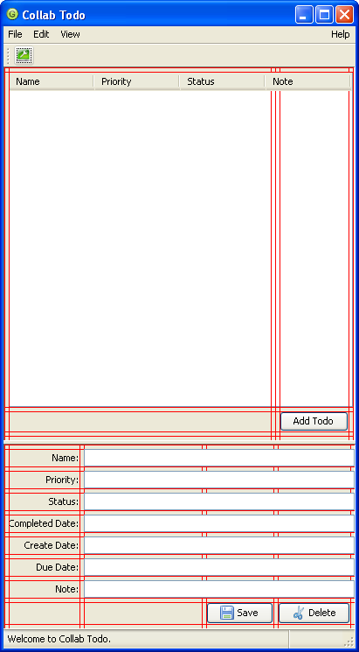
JGoodies FormDebugPanel

Slide 33
Content Pane
Glazed Lists
// Setup the Todo Details form using JGoodies Forms
FormLayout layout2 = new FormLayout(
"3dlu,right:pref, 3dlu, 90dlu, 3dlu, pref, 3dlu, pref, 3dlu", // columns
"3dlu, p, 3dlu, p, 3dlu, p, 3dlu, p, 3dlu, p, 3dlu, p, 3dlu, p, 3dlu, p, 3dlu"); // rows
panel(layout: layout2) {
label(constraints: cc.xy(2, 2), text: "Name:")
widget(constraints: cc.xyw(4, 2, 6),
new JTextField(columns: 20), id: "nameTextField")
label(constraints: cc.xy(2, 4), text: "Priority:")
widget(constraints: cc.xyw(4, 4, 6),
new JTextField(columns: 20), id: "priorityTextField")
. . .
widget(constraints: cc2.xy(6, 16),
id: "saveButton", new JButton(saveAction))
widget(constraints: cc2.xy(8, 16),
id: "deleteButton", new JButton(deleteAction))
}

Slide 34
Content Pane
// Data Bind the fields (view) to the model.
// sourceValue = model
// target = view
bind(source: swing.table.selectionModel,
sourceEvent: 'valueChanged',
sourceValue: { selectedTodo()?.name },
target: swing.nameTextField, targetProperty: 'text')
bind(source: swing.table.selectionModel,
sourceEvent: 'valueChanged',
sourceValue: { selectedTodo()?.priority },
target: swing.priorityTextField, targetProperty: 'text')
bind(source: swing.table.selectionModel,
sourceEvent: 'valueChanged',
sourceValue: { selectedTodo()?.status },
target: swing.statusTextField, targetProperty: 'text')
. . .

Slide 35
DEMO

Slide 36
Review
✓
✓
✓
✓
✓
✓
✓
✓

Slide 37
Interacting with
RESTful WebServices
Action | SQL Method | HTTP Method | Grails Convention
Create | INSERT | PUT | create
Read | SELECT | GET | show
Update | UPDATE | POST | update
Delete | DELETE | DELETE | delete
Collect | SELECT |  | list

Slide 38
Controller - loadData()
void loadData() {
status "Loading Data“
swing.splitPane.setCursor(hourglassCursor)
def get = new Get(url: APP_URL,
userName: loginService.name,
password: new String(loginService.password))
def todos = new XmlSlurper().parseText(get.text )
todoEventList.clear()
todoEventList.addAll(todos.todo.list())
swing.splitPane.setCursor(normalCursor)
status "Finished Loading Data"
}

Slide 39
Get (httpUtils)
class Get{
String url
QueryString queryString = new QueryString()
String text
def userName
def password
String getText(){
def response
def conn = new URL(toString()).openConnection()
conn.requestMethod = "GET"
conn.doOutput = true
if (userName && password) {
conn.setRequestProperty("Authorization", "Basic ${userName}:${password}")
}
if (conn.responseCode == conn.HTTP_OK) {
response = conn.content.text
} else {
response = "URL: " + this.toString() + "\n" + "RESPONSE CODE: " + responseCode
}
conn.disconnect()
return response
}
String toString() { return url + "?" + queryString.toString() }
}

Slide 40
Controller - saveData()
void saveTodo(event) {
// Update Summary Table
selectedTodo().name = swing.nameTextField?.text
selectedTodo().priority = swing.priorityTextField?.text
selectedTodo().status = swing.statusTextField?.text
selectedTodo().completedDate = swing.completedTextField?.text
selectedTodo().createDate = swing.createTextField?.text
selectedTodo().dueDate = swing.dueTextField?.text
selectedTodo().note = swing.noteTextField?.text
// Save or Update?
// if Don't have an id then save else update
def selectID = selectedTodo().@id

Slide 41
Controller - saveData()
if (selectID == "" || !selectID ) {
def put = new Put(url: APP_URL, userName: loginService.name,
password: new String(loginService.password))
put.queryString.add("name", selectedTodo().name)
put.queryString.add("priority", selectedTodo().priority)
put.queryString.add("status", selectedTodo().status)
put.queryString.add("note", selectedTodo().note)
put.queryString.add("owner.id", userInfo.@id)
// Construct a create date
Calendar createDate = Calendar.getInstance();
def cdYear = createDate.get(Calendar.YEAR)
def cdMonth = createDate.get(Calendar.MONTH) + 1
def cdDay = createDate.get(Calendar.DAY_OF_MONTH)
def cdHour = createDate.get(Calendar.HOUR_OF_DAY)
def cdMin = createDate.get(Calendar.MINUTE)
put.queryString.add("createdDate", "struct&createdDate_hour=${cdHour}&createdDate_month=${cdMonth}&createdDate_minute=${cdMin}&createdDate_year=${cdYear}&createdDate_day=${cdDay}")
} else { . . . }
loadData()
}

Slide 42
Put (httpUtils)
class Put{
QueryString queryString = new QueryString()
String url, content, contentType, text
def userName
def password
String getText(){
def conn = new URL(url).openConnection()
conn.setRequestMethod("PUT" )
conn.setRequestProperty("Content-Type" , contentType)
conn.doOutput = true
conn.doInput = true
if (userName && password) { conn.setRequestProperty("Authorization", "Basic ${userName}:${password}") }
conn.outputStream.withWriter { out -> out.write(queryString.toString())
out.flush()
out.close()
}
def response
if (conn.HTTP_OK == conn?.responseCode) { response = conn.content.text
} else { response = "URL: " + this.toString() + "\n" + "RESPONSE CODE: " + responseCode }
conn.disconnect()
return response
}
String toString() { return url + "?" + queryString.toString() }
}

Slide 43
QueryString
class QueryString{
Map params = [:]
// this constructor allows you to pass in a Map
QueryString(Map params){
if(params){
this.params.putAll(params)
}
}
// this method allows you to add name/value pairs
void add(String name, Object value){
params.put(name, value)
}
// this method returns a well-formed QueryString
String toString(){
def list = []
params.each { name, value->
list << "${name}=" + value.toString()
}
return list.join("&" )
}
}

Slide 44
Controller - deleteTodo()
void deleteTodo(event) {
def delete = new Delete(
url: APP_URL +"/${selectedTodo().@id}",
userName: loginService.name,
password: new String(loginService.password))
delete.text
loadData()
}

Slide 45
Delete (httpUtils)
class Delete{
String url
QueryString queryString = new QueryString()
def userName
def password
String getText(){
def response
def conn = new URL(toString()).openConnection()
conn.requestMethod = "DELETE"
conn.doOutput = true
if (userName && password) { conn.setRequestProperty("Authorization", "Basic ${userName}:${password}") }
if (conn.responseCode == conn.HTTP_OK) {
def input = conn.inputStream
input.eachLine { response += it }
} else {
return "URL: " + this.toString() + "\n" + "RESPONSE CODE: " + responseCode
}
conn.disconnect()
return response
}
String toString() { return url + "?" + queryString.toString() }
}

Slide 46
The Results
Menu Bar
Tool Bar
Login Dialog
Content Area
Tips Dialog
Status Bar

Slide 47
How did we do
Menu Bar
Tool Bar
Status Bar
About Box
Tips
Login Dialog
Master / Detail Content Area
  Table and Fields
Wire it together with Actions
Make calls to Web Service
✓
✓
✓
✓
✓
✓
✓
✓
✓

Slide 48
RESTful Web Services

Slide 49
RESTful WebServices

Slide 50
UserInfoController
class UserInfoController {
def index = { redirect(action:show,params:params) }
def show = {
def result = session.user
format(result)
}
def beforeInterceptor = {
def authHeader = request.getHeader("Authorization")
if (authHeader) {
def tokens = authHeader.split(' ')
def user_password = tokens[1]
tokens = user_password.split(':')
def userid = tokens[0]
def password = tokens[1]
// At this point, the userid and password could be verified
// to make sure that the person making the request is authenticated
//
// << AUTHENTICATION LOGIC / CALL >>
// Put looked up the user object and put it into session for use later by the controllers.
def user = User.findByUserName(userid)
if (user) { session.user = user }
else { session.user = null }
}
}
private format(obj) {
def restType = (params.rest == "rest")?"XML":"JSON“
render obj."encodeAs$restType"()
}
}

Slide 51
Reference Material
Beginning Groovy and Grails
http://BeginningGroovyAndGrails.com
Groovy GUI Programming
http://groovy.codehaus.org/GUI+Programming+with+Groovy
JGoodies
http://JGoodies.com
SwingLabs
http://SwingLabs.org
GlazedLists
http://PublicObjects.org/glazedlists

Slide 52
Conclusion
Thanks for your time
  Questions?
Blog: http://jshingler.blogspot.com
Email: ShinglerJim@gmail.com
LinkedIn: http://linkedin.com/in/jimshingler
Twitter: http://twitter.com/jshingler

Slide 53

Glazed Lists

